Slide 1
Backpropagation Learning Algorithm
Early slides modified from those of Marc Pomplun, UMB; many other sources are available on the internet, but use slightly different notation.

Slide 2
Example: a one-hidden layer 3-4-2 feedforward network
Network function f: R³ → R²
output vector
o₁
o₂
output layer
hidden layer
input layer
x₁
x₂
x₃
input vector

Slide 3
Sigmoidal Neurons
f_{i}(net_{i}(t))
τ = 0.1
1
τ = 1
0
-1
1
net_{i}(t)

Slide 4
Sigmoidal Neurons
This result will be very useful when we develop the backpropagation algorithm.

Slide 5
Backpropagation Learning
Similar to the Adaline (LMS) algorithm, the goal of the Backpropagation learning algorithm is to modify the network’s weights so that its output vector
o_{p} = (o_{p,1}, o_{p,2}, …, o_{p,K})
is as close as possible to the desired output vector
d_{p} = (d_{p,1}, d_{p,2}, …, d_{p,K})
for K output neurons and input patterns p = 1, …, P.
The set of input-output pairs (exemplars) {(x_{p}, d_{p}) | p = 1, …, P} constitutes the training set.

Slide 6
Backpropagation Learning
Also similar to the Adaline, we need a cumulative error function that is to be minimized:
We can choose the mean square error (MSE) once again (but the 1/P factor does not matter):
where

Slide 7
Backpropagation Learning
For input pattern p, the i-th input layer node holds x_{p,i}.
Net input to j-th node in hidden layer:
Output of j-th node in hidden layer:
Net input to k-th node in output layer:
Output of k-th node in output layer:
Network error for p:

Slide 8
Backpropagation Learning
As E is a function of the network weights, we can use gradient descent to find those weights that result in minimal error.
For individual weights in the hidden and output layers, we should move against the error gradient (omitting index p):
Output layer: Derivative easy to calculate
Hidden layer: Derivative difficult to calculate

Slide 9
Backpropagation Learning
When computing the derivative with regard to w_{k,j}^{(2,1)}, we can disregard any output units except o_{k}:
Note that o_{k} is obtained by applying the sigmoid function S to net_{k}⁽²⁾, which is computed by:
Therefore, we need to apply the chain rule twice.

Slide 10
Backpropagation Learning
We know that:
Since
We have:
Which gives us:

Slide 11
Backpropagation Learning
For the derivative with regard to w_{j,i}^{(1,0)}, notice that E depends on it through net_{j}⁽¹⁾, which influences each o_{k} with k = 1, …, K:
Using the chain rule of derivatives again:

Slide 12
Backpropagation Learning
This gives us the following weight changes at the output layer:
… and at the inner layer:

Slide 13
Backpropagation Learning
Using the sigmoid gradient expression:
Then we can simplify the generalized error terms:
And:

Slide 14
Backpropagation Learning
The simplified error terms δ_{k} and μ_{j} use variables that are calculated in the feedforward phase of the network and can thus be calculated very efficiently.
Restating the final equations, using subscript p for the p-th pattern:

Slide 15
Backpropagation Learning (High Level)
Algorithm Backpropagation;
Initialize network;
while termination criteria are not met, do
for each input pattern x_{p}, 1 ≤ p ≤ P,
Feedforward computation of all node outputs;
Loss Function Computation at network outputs;
Weight modifications (outer layers first)
end-for
end-while.

Slide 16
Backpropagation Learning (with some details)
Algorithm Backpropagation;
Start with randomly chosen weights;
while MSE is above desired threshold and computational bounds are not exceeded, do
for each input pattern x_{p}, 1 ≤ p ≤ P,
Compute hidden node inputs;
Compute hidden node outputs;
Compute inputs to the output nodes;
Compute the network outputs;
Compute the error between output and desired output;
Modify the weights between hidden and output nodes;
Modify the weights between input and hidden nodes;
end-for
end-while.

Slide 17
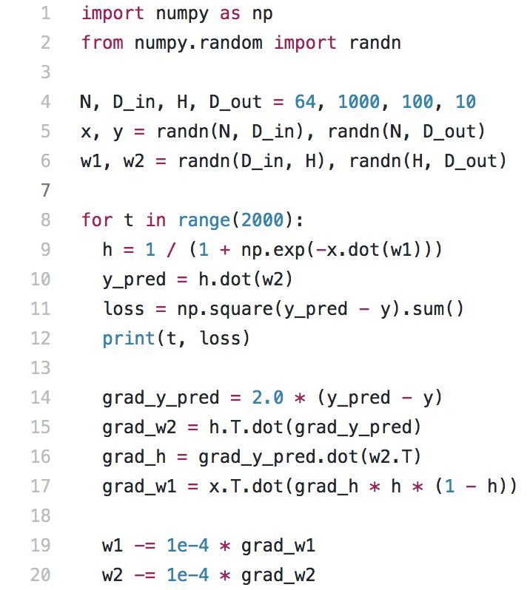
Backprop code in Python (by Li, Johnson, and Young)

Slide 18
Potential problems with back-propagation for deep networks
Vanishing gradients: weight changes depend on the chain rule, multiplying many quantities if the network is deep, some of which are almost 0 (when a first derivative is very small).
Exploding gradients: The opposite problem occurs when many large numbers are multiplied.
Computational effort: too many derivatives must be calculated.
Gradient calculation: we may like to use non-differentiable node functions or loss functions.
Getting stuck in local optima: No guarantee of finding best solution; deep networks would have many more local optima.
Non-parallelizability: calculations and weight updates cannot be simultaneously performed for two layers.

Slide 19
Useful websites
https://www.nnwj.de/backpropagation.html (an example)
http://www.mnemstudio.org/ai/nn/backprop_4x6x14_python.txt
(more elaborate Python code for a specific example)
https://int8.io/backpropagation-from-scratch-in-julia/

